Slide 1
Community Relationship Map Tool
This tool was designed to support your organization in assessing its relationship to different constituencies and networks.
It can be most useful when utilized on a regular basis to increase your awareness of the social groups that shape major decisions in your defined community, and help you self-reflect on your organization’s location in that system.

Slide 2
Who Should Use This
We recommend inviting a diverse group of collaborators to participate in this mapping activity, and suggest that you consider diversity according to:
Organizational tenure and role (eg: Program Director, volunteer, most senior Board member)
Social identities (eg: cultural/ethnic minority groups, gender, age)
Participation in other networks or groups (eg: Sierra Club, Parent Teacher Associations, Immigrant Rights Groups)

Slide 3
Time and Materials
Expect to spend 1-4 hours on this activity, depending on how many collaborators you invite in the process.
Collaborators can engage this tool in person using flipcharts, whiteboards, or chalkboards by following the outlined steps.
For virtual collaboration, we recommend converting this into a shareable Google Slide for others to access and contribute to.

Slide 4
How to Use the Community Power Map
Prework – People
Prework – Vision
Brainstorm
Reflect on what you don’t know
Consider reach & scale
Create your map
Revisit map

Slide 5
Example of a completed map
Economic
BIPOC
Affinity Groups
Alcoa
Tea party
Neighbor Assoc's
0
Ranchers
Kaiser Permanente (hospital)
Hmong Comm. Center
Refugees Center
PTA
1
Ski Resort
Youngnonprofit league
Tribal Center
Land trust
Latino Arts
2
Tourism Assoc
MADD
SEIU
CJA
Mtn Bike Assoc
BLM 5280
3
Audubon
4
Water shed Alliance
PSR
5
MY ORGANIZATION

Slide 6
1. Pre-Work - People
Start with People - Obtain any data available about who lives in your defined geography. Begin with demographic records and any other data, such as employment studies, party membership, voter turnout, etc.
  Census.gov is a good place to start
  Recognize that some minority and immigrant communities may be undercounted in official records, especially those at risk for deportation. Adjust your map accordingly.

Slide 7
2. Pre-Work - Vision
Know your goals and define your geography - draft a vision that includes your conservation goals and other issues that are important to your community.
  Be clear about your vision and long-term power building goals
    Consider a really BIG vision for your work. One that includes the people, and the issues that matter to them, that surround your conservation goals. What might it take for the broader community to support your vision for conservation? A healthy economy that doesn’t rely on resource extraction? A health care system that addresses the needs of all? Affordable housing? What other issues and concerns are your potential allies fighting for that prevents them from being able to support conservation issues more actively?
  Ensure your goals are rooted in your mission and values
  Identify the geographies (cities, counties, etc.) where your movement needs to increase its social power to change public sentiment or influence decision-makers
    Take special notice of what you don’t know, what communities or demographics aren’t represented in your vision. Look to build those in over time.

Slide 8
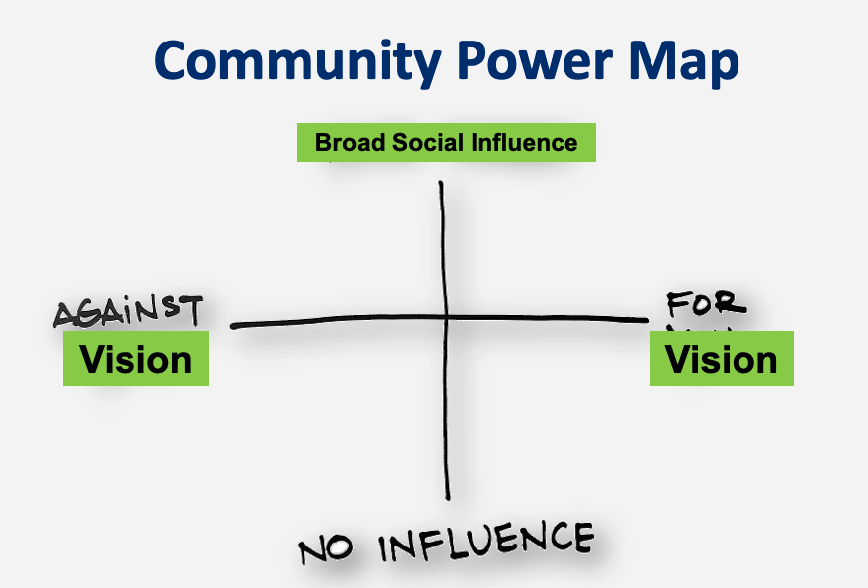
2. Pre-Work - Vision
  Place a symbol that represents your vision on the far end of the right axis
  Place something that represents the opposite on the far left end

Slide 9
3. Brainstorm
Conduct multiple brainstorms about where people who identify in particular ways connect and influence one another.
Geographically:
How much is rural, urban, suburban?
Are you looking to build power in a specific region, city, or neighborhood?
How do people in those geographies identify themselves and how do they connect with one another?
Economically:
How do people make a living?
Are there large numbers of people who work for a single company or sector?
Are there associations, organizations, or publications for these communities?
Affinities & Interests:
How do people spend their free time?
How and where do families spend time together?
What are young people doing?
Religious, faith, cultural centers?
Who brings these people together, where do they connect, etc.?
Media sources:
Are there community specific media sources for specific interests, demographics, people who speak a specific language, etc.?

Slide 10
4. Reflect on what you don’t know
After brainstorming, look back to your demographic info and determine what you don’t know.
Are there underrepresented communities in your geography and are you lacking information about where they work, connect, etc.?
Make note of what you don’t know and look for ways to learn more about your entire community.

Slide 11
5. Consider Reach & Scale - Filling in Circles for networks
Fill your circles: The circles on the next slide will represent the networks, groups, and affiliations you brainstormed.
Create a customized scale for your map and to help you determine how high or low their sphere of influence is and their corresponding place on the grid.
  For example, if you are working in a single city, a group reaching 1000 people might be the middle axis with larger networks above and smaller ones below. If you are working in a rural community, that number for the middle axis may be smaller, and if statewide, much larger. Also keep in mind that size isn’t everything, a leader of a church with 50 active members probably has more influence than a club that has 200 people on its mailing list but doesn’t ever gather in person.
Consider:
How large is the reach of these groups? For example, if you are working in a single city, a small circle might reach dozens of people, medium reaching hundreds, and a large one thousands. The scale depends on the scope of your defined community.
What is the strength of their influence? For example, the leaders of a particular religious community or labor union may have a lot of influence with the folks in their community. A mountain biking association may have less with theirs. Shade the circles by how strong you believe their influence to be with their networks.

Slide 12
Duplicate this slide if you need more circles; copy the elements from this slide to place on map slide when you are ready
Name
Name
Name
Name
Name
Name
Name
Name
Name
Name
Name
Name
Name
Name
Name
Name
Name
Name
Name
Name
Name
Name
Name
Name
Name
Name
Name
Name
Name
Name
Name
Name
Name
Name
Name
Name
Name
Name
Name
Name
Name
Name
Name
Name
Name
Name
Name
Name
Name
Name
Name

Slide 13
6. Create Your Map
Place the circles on the map along the Y-axis in relation to your organization. Feel free to customize what these levels indicate. For example,
  0 = you have an antagonistic relationship
  1 = no relationship
  5 = closest partner; you actively communicate, collaborate, and there is strong trust, etc.
  You may not have any 5s yet, and that’s ok
Place groups in the colored columns that identify them as rooted in an economic basis, other interest/affinity, or representing Black, Indigenous, and other people of color (BIPOC) communities
  You can customize these categories; however, these categories likely reflect most community interests.
  We strongly recommend retaining one column for BIPOC communities to keep them visible and part of your consideration.

Slide 14
Feel free to zoom in and out to view this slide with more detail as you fill it in, especially if you need to adjust circle sizes to accommodate all your groups.
Economic
BIPOC
Affinity Groups
0
1
2
3
4
5
MY ORGANIZATION

Slide 15
7. Revisiting Your Map
Remember, the purpose of this tool is to help you reflect on your relationships with others, and the community at large, in order to help you set goals for the relationships you hope to have.
This tool is a living document; it should evolve as your relationships evolve.
This tool is not a scorecard. The goal isn’t to have all 5s as much as it is to have a better understanding of the social power in your community. Always be asking yourself:
  Where does my organization live on this map and how are we building our social power? This might be through building our community, partnerships with others, or both.
  Who is likely to have a similar vision? How can we learn from one another to create alignment? How can we help each other build power and move up our map?
  Who might we be able to move closer to our vision? Where would we have to build relationships in order to better understand them and help them understand us?
  Are there communities, networks, or demographics missing from your map?
  What are our strengths and those of our potential allies? What other types of power do we, and others, hold that through cooperation would allow us to build power together? Do we have access to a particular community or decision-makers that others lack? Do they have policy, fundraising, or organizing expertise we could learn from?

